Slide 1


Fish Behavior Detection
Gonçalo Adolfo
Teachers Alexandre Bernardino and H.Sofia Pinto
Instituto Superior Técnico, Universidade de Lisboa

Slide 2
Outline
Motivation/goal
System components
Trajectory pre-processing
Detection of interesting moments
Anomaly detection
Feeding
Next steps

Slide 3

Motivation
Water quality
Aggressive behaviors
Poor environmental integration
Disease indicators
real time monitoring
footage analysis

Slide 4


Project Goals
Purpose: help biologists monitoring fishes
Swallowing air
moves to the surface
Feeding
aggregation near the surface (sharks)
Indian queue (mantas)
Lack of interest
not interested in food during feeding period
Abnormal
direction changes
velocity changes
spatial zone
motion shape

Slide 5


Project Context
“Video based live tracking of fishes in tanks”
José Castelo (2019/2020)
Detection: background subtraction
Tracking: position and color
Classification: color histogram or HOG
“Tracking animals in underwater videos”
João Santos (2020/2021)
Detection: comparison of several techniques
Tracking: color history, temporary track, motion prediction

Slide 6
System Components
Goal: detect fish behaviors and give alerts to biologists
Behavior Detection Module
Detection
Tracking
Rule-Based
Machine Learning
Web Application

Slide 7
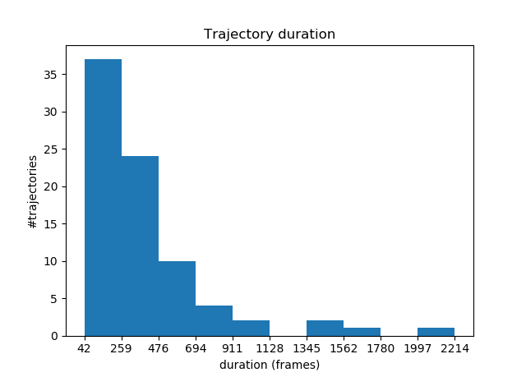
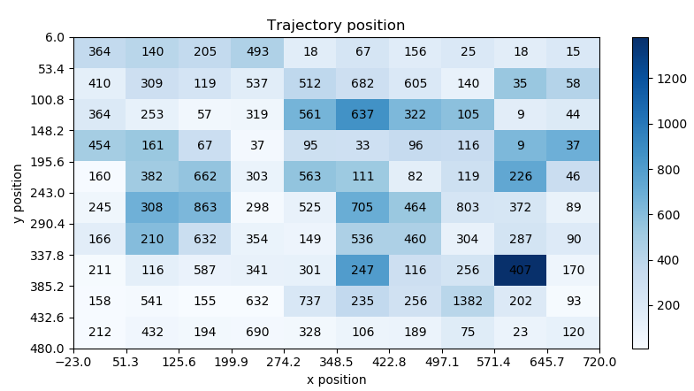
Trajectories

Slide 8
Pre-Processing
Interpolation
Filtering
Segmentation

Slide 9
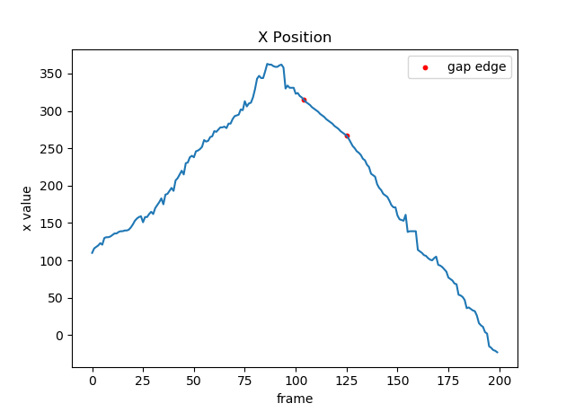
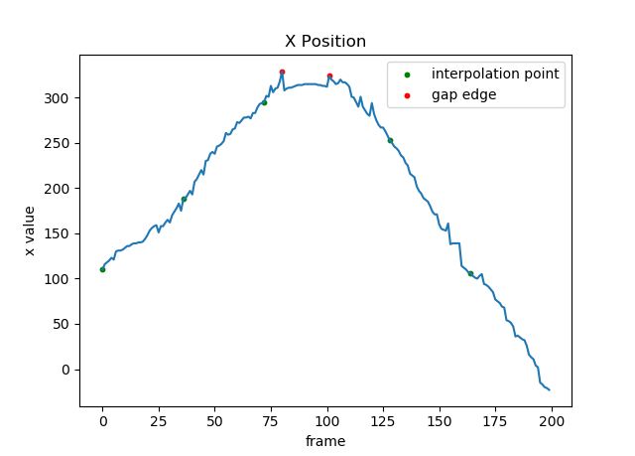
Interpolation
Linear
Newton polynomial

Slide 10
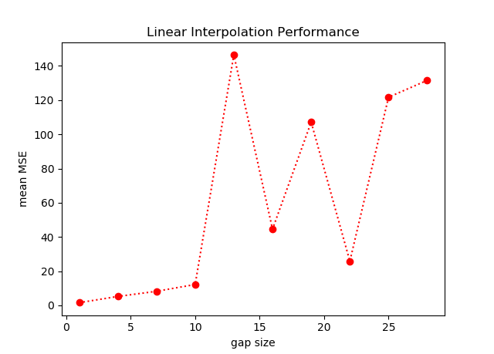
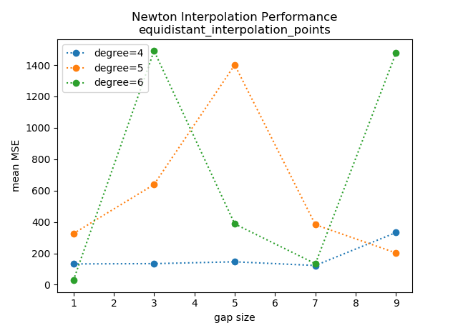
Linear vs Newton

Slide 11

Interpolation example

Slide 12
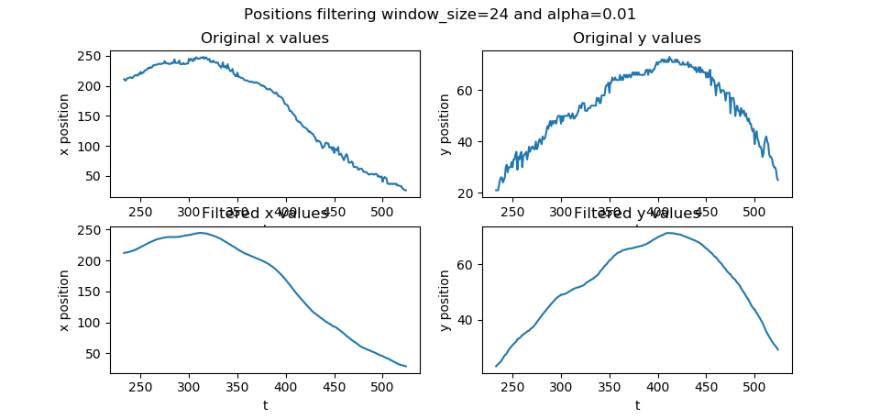
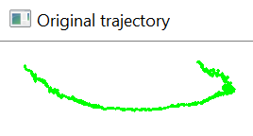
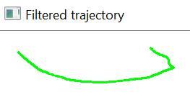
Filtering

Slide 13
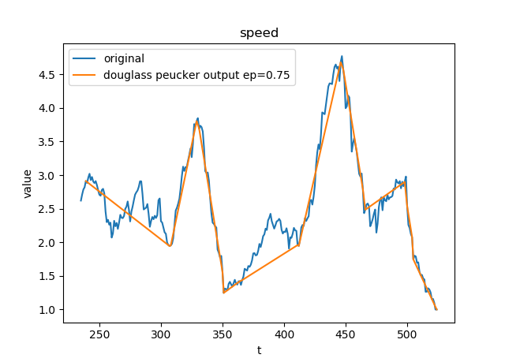
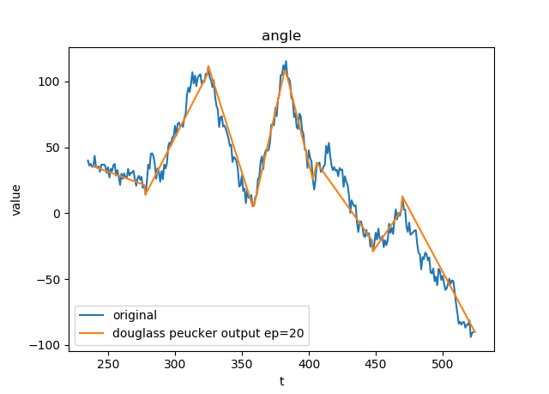
Segmentation

Slide 14

Segmentation

Slide 15
Behaviors
Moments of interest
Anomalies
Feeding

Slide 16

Moments of interest - Definition
very static
direction sudden changes
speed sudden changes
high speed
too much direction changes
manta rays swimming on the bottom
sharks' aggregation
more than 3 manta rays swimming together
repetitive movements

Slide 17
Feature Extraction
Velocity, Acceleration and Turning angle
Curvature Scale Space
Centered Distance Function
“Pass by” features
Normalized bounding box

Slide 18
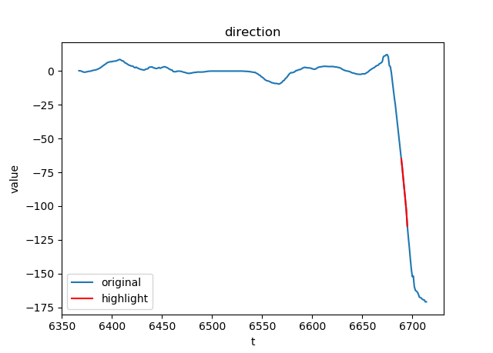
Moments of interest – rule based
Rule
Feature
Values
Duration
Highlighter
…

Slide 19
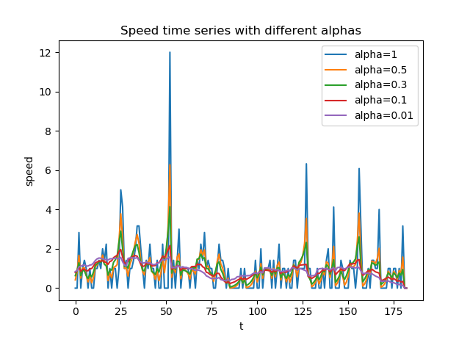
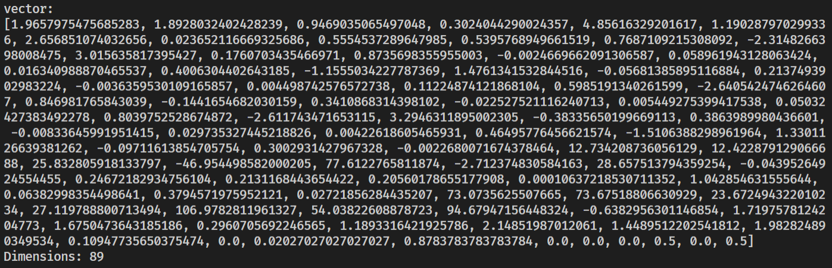
Moments of interest – Machine Learning
Mean
Median
Min
Max
Quartiles
Auto correlation

Slide 20
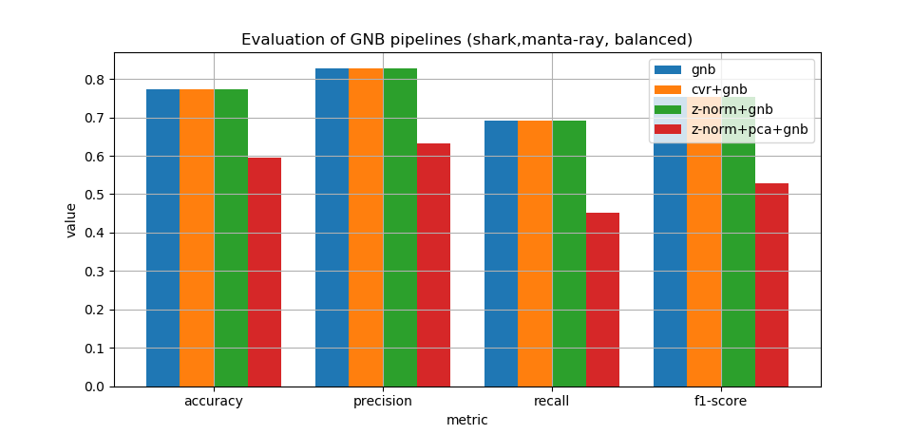
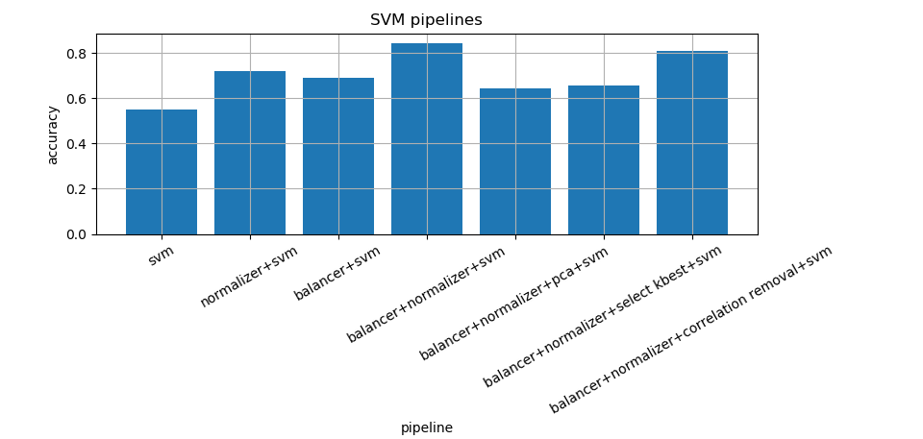
Moments of interest – Machine Learning

Slide 21
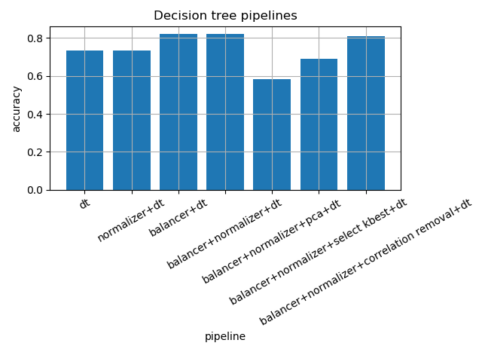
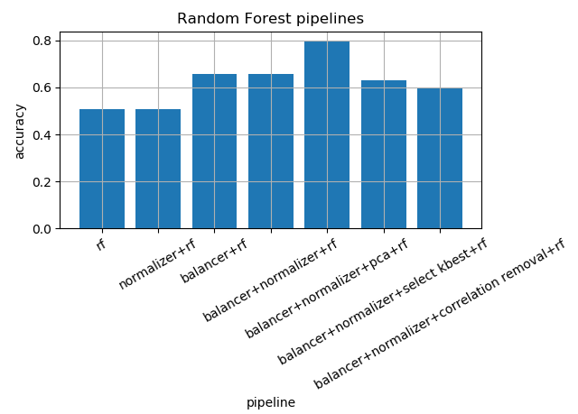
Moments of interest – Machine Learning

Slide 22
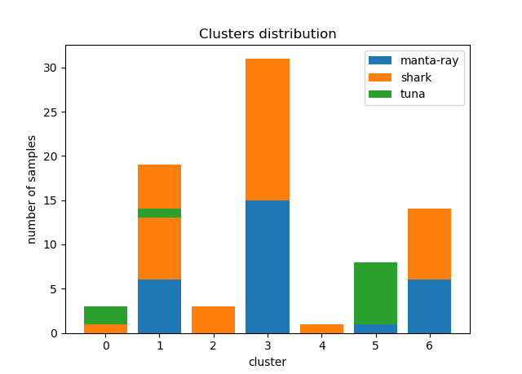
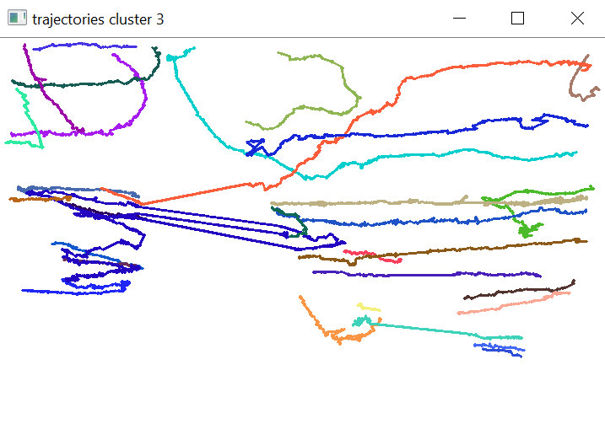
Anomaly detection

Slide 23
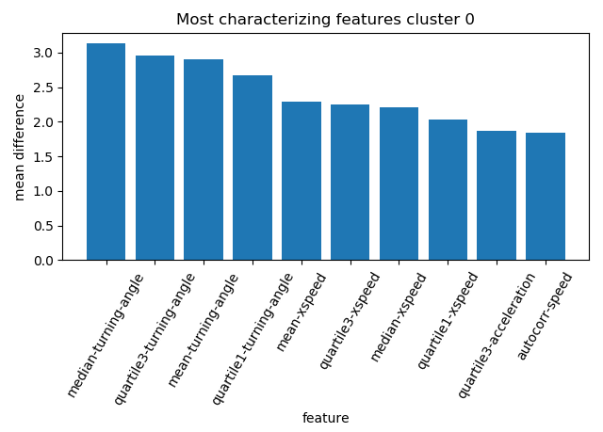
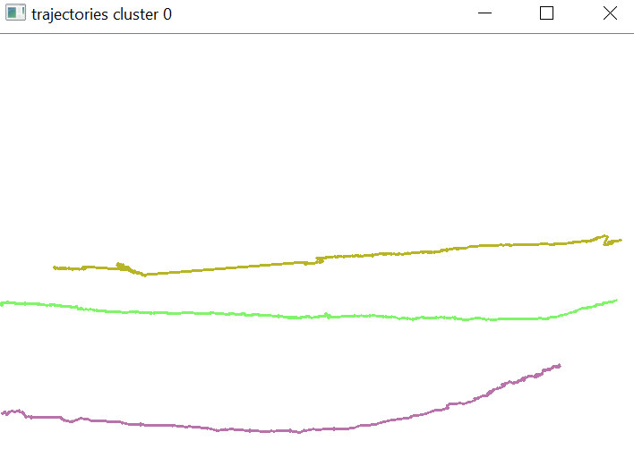
Anomaly detection

Slide 24
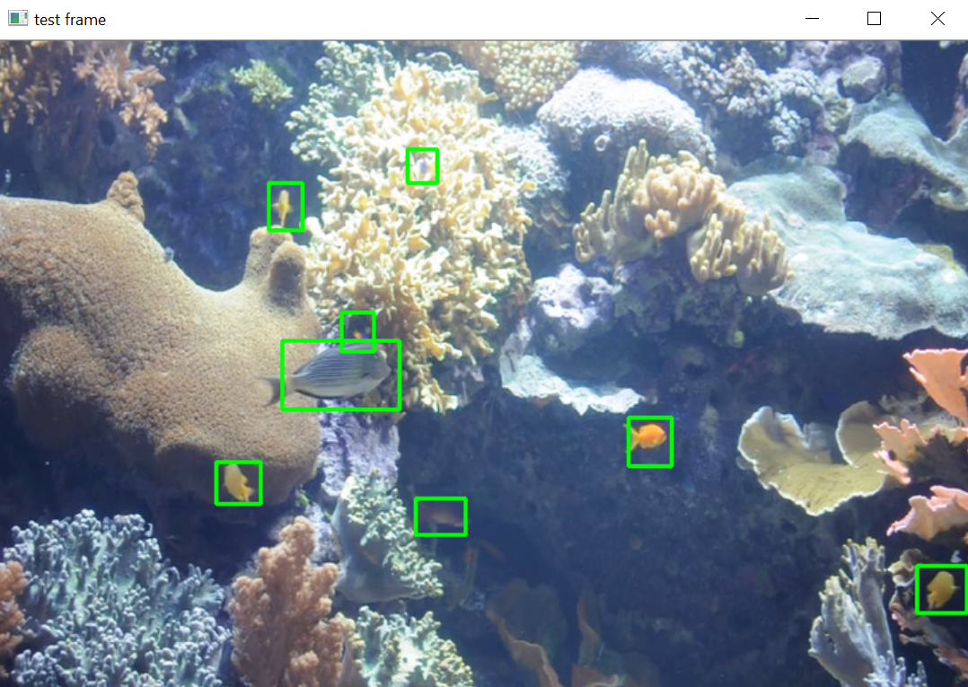
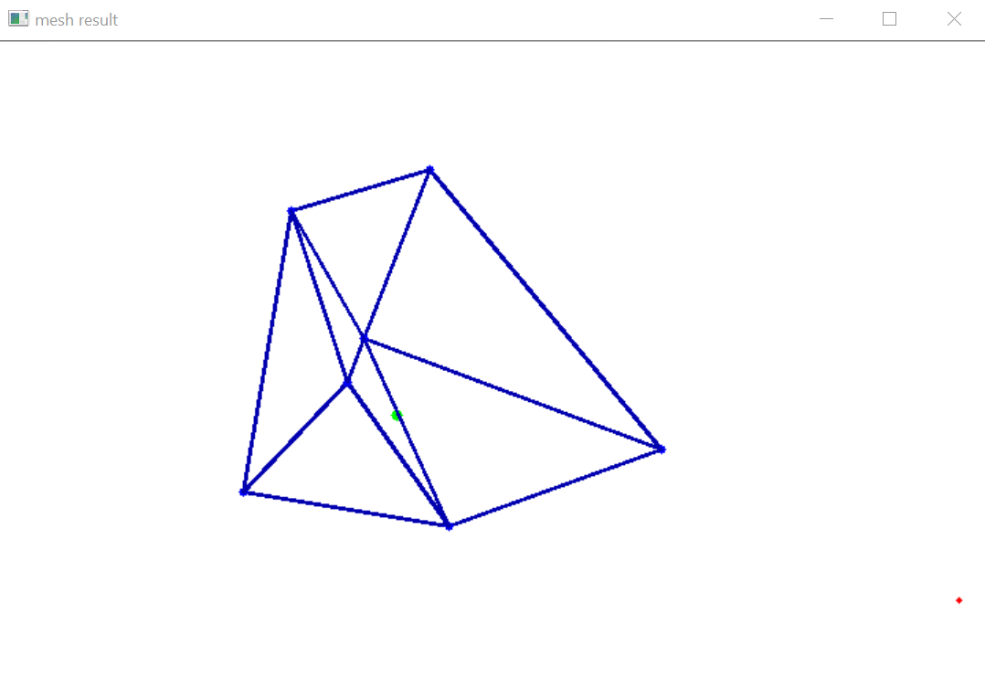
Feeding

Slide 25
Next steps
Anomaly detection using other algorithms: vector fields
Segments classification
System pipeline: server, workers, database, services, web application

